Slide 1
RDC allocation
Yunzhong “Gary” Gao
yunzhong_gao@homedepot.com

Slide 2
RDC allocation
RDC Allocation Documents Share folder Path:
\\at2a5\vol4\DEPTS\TRAFFIC\PROJECTS\SCD\Supply Chain Analytics\Projects\Gary Gao\OverrideUpload_allocation\RDC_allocation
Uipath Main file: RDC_allocation_final_test_Oct
Uipath process and schedule: RDC_allocation 1.0.26

Slide 3
Uipath Process step by step
0. Set Config to print out logs in Slack Channel “﻿rdc-allocation-bot”
1. Create Template for Load FastPass
2. Load / Upload Fastpass template
3. Allocate trailers /click RDC-ASN
4. Create Template for Load IBOT Priorities
5. Load IBOT Priorities
Every step from 1 to 5 is corresponding to uipath steps

Slide 4
Create Template for Load FastPass 1
1. let bot open cmd and change directory to C:\Users\sxb8nbs\AppData\Local\Programs\Python\Python37
2. run upload_file_auto.py ( check the same codes in \\at2a5\vol4\DEPTS\TRAFFIC\PROJECTS\SCD\Supply Chain Analytics\Projects\Gary Gao\OverrideUpload_allocation\Python Codes\ upload_file_auto.py )

Slide 5
Create Template for Load FastPass 2
3. upload_file_auto.py is for building allocation of skus in each trailer based on STORE_RANK,VIRT_EXPCTD_ALLOC_QTY,WOS and save as a template in \\at2a5\vol4\DEPTS\TRAFFIC\PROJECTS\SCD\Supply Chain Analytics\Projects\Gary Gao\OverrideUpload_allocation with today’s date and no. of files (each file rows should be less than 2000) :
E.g.
4. send email to Obi, Christie and Gary

Slide 6
Load / Upload Fastpass template
1.Go to website :
https://rdc-allocation override.apps.homedepot.com/home
2.Fill in password and Idap
(password and Idap store as pw and user in variable: should change by developer every 6 months!!! )
3.Upload the Fastpass template files which just created:
\\at2a5\vol4\DEPTS\TRAFFIC\PROJECTS\SCD\Supply Chain Analytics\Projects\Gary Gao\OverrideUpload_allocation with today’s date and no. of files
4. send email to Obi, Christie and Gary

Slide 7
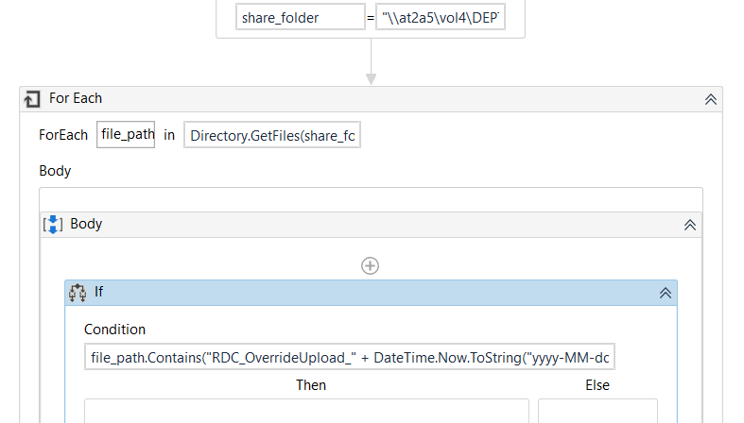
Load / Upload Fastpass template

Slide 8
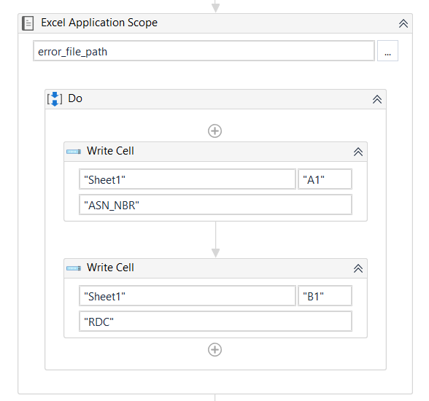
Allocate trailers /click RDC-ASN
1. create empty error files .xlsx with date in \\at2a5\vol4\DEPTS\TRAFFIC\PROJECTS\SCD\Supply Chain Analytics\Projects\Gary Gao\OverrideUpload_allocation\error_files
2. error files contain two columns :
ASN_NBR, RDC

Slide 9
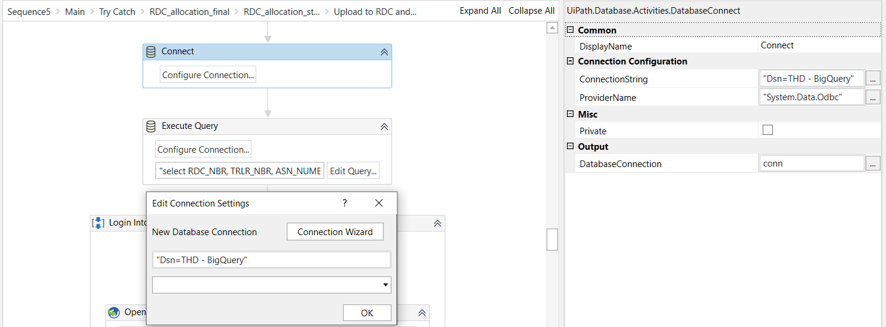
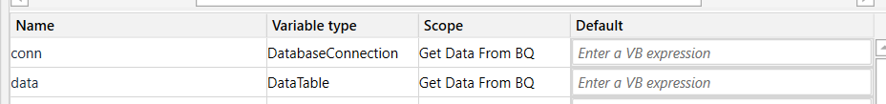
3. Connect to Bigquery in odbc

Slide 10
4. Execute query to get rankings of RDC_NBR and ASN :
select RDC_NBR, TRLR_NBR, ASN_NUMBER, rn as RNK from (
select *, row_number() over( partition by RDC_NBR order by DISPO, RNK) as rn from (
select RDC_NBR, TRLR_NBR, ASN_NUMBER, DISPO, min(RNK) as RNK from `analytics-supplychain-thd.DISTRO.FP_PLAY_DLY`
where cal_dt = current_date
group by 1,2,3,4)
order by 1,4)

Slide 11
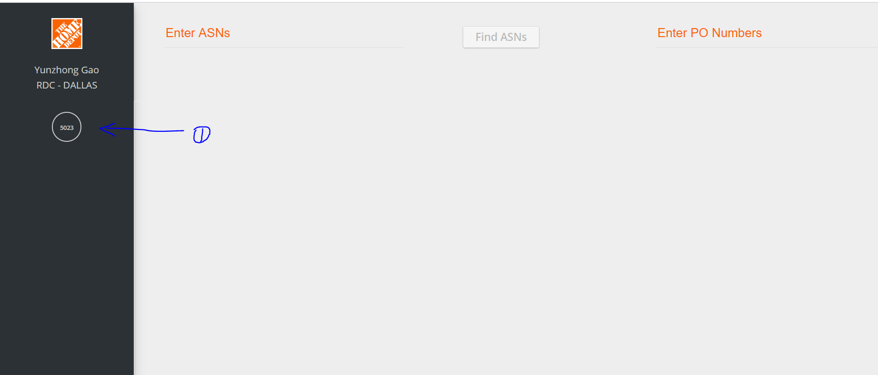
Allocate trailers /clicking RDC/ASN
5. Go to website https://webapps.homedepot.com/RDCAllocUI
6. Fill in Ldap and password (also as user and pw in variable)

Slide 12
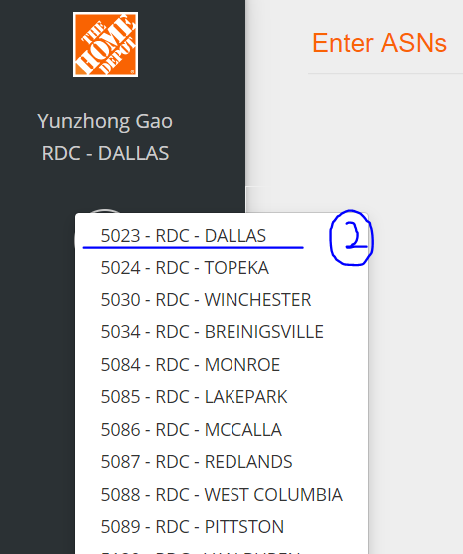
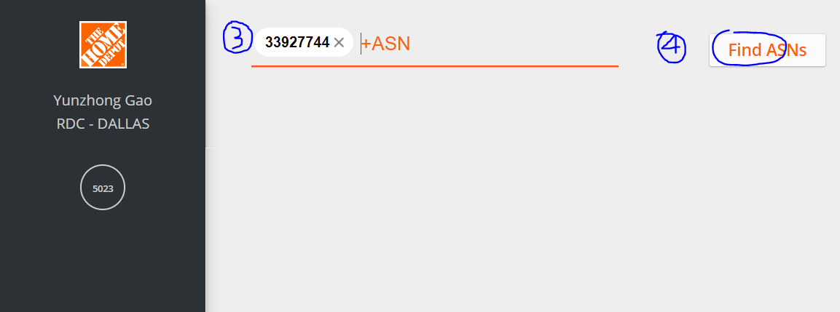
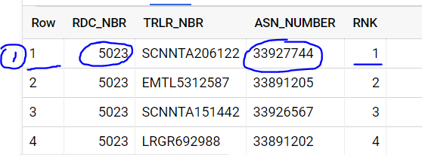
1.Find the RDC_NBR and ASN_NUMBER based on RNK e.g.5023 for RDC and 33927744 for ASN
2. Click on the circle and select “5023”
3. Then fill in “33927744” as ASN and press ‘Enter’
4. Click “Find ASNS”

Slide 13
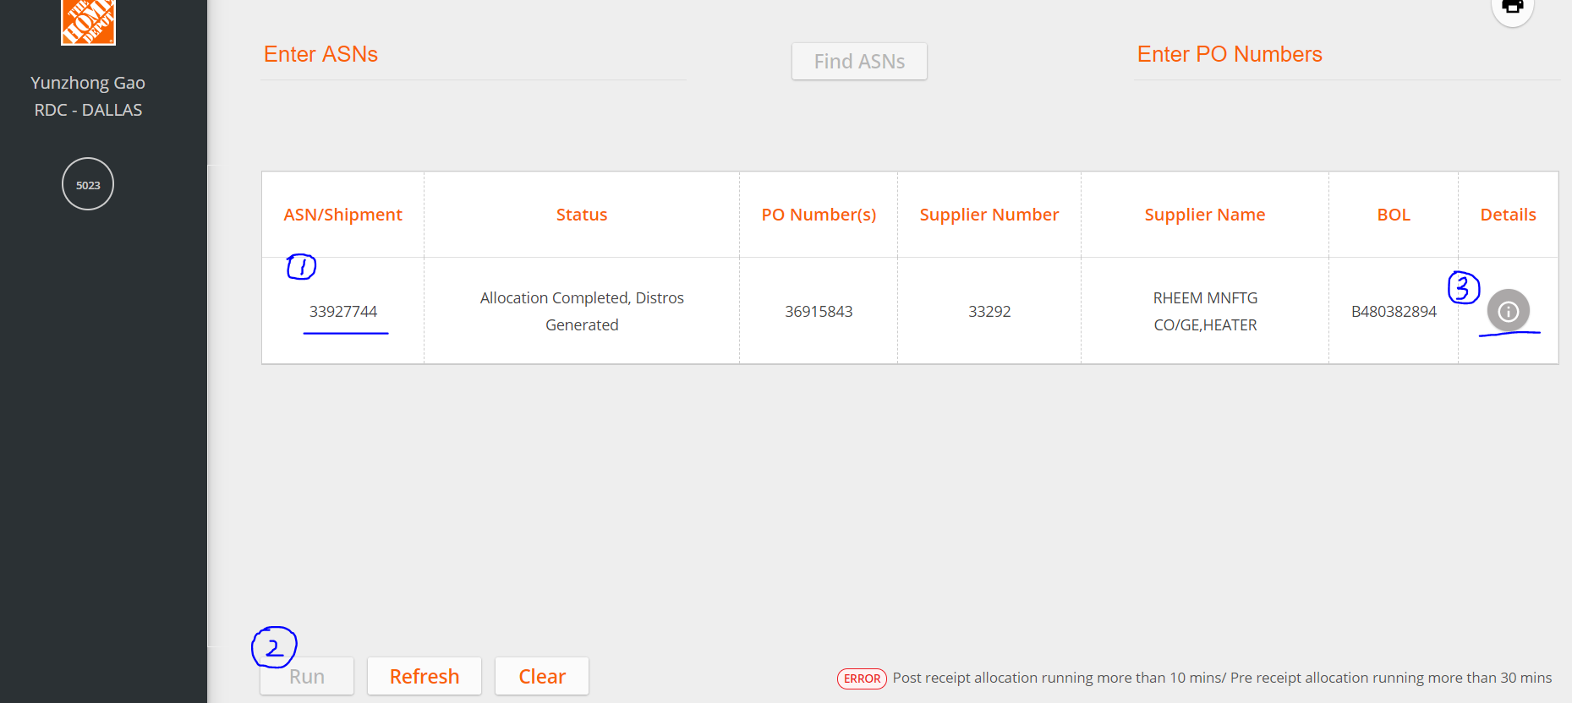

Click on “33927744” button at column ASN
Click on “Run” ( it will turn into orange)
If there is a grey “Run” or a exclamation mark at details , fill the ASN 33927744 and BDC 5023 in the created error excel file
Repeated the process for next RDC/ ASN e.g. 5023/33891205 for RNK 2…
5. After finishing all the clicks of RDC/ASN, send email to Obi, Christie and Gary

Slide 14
Create Template for Load IBOT Priorities 1
1. let bot open cmd and change directory to C:\Users\sxb8nbs\AppData\Local\Programs\Python\Python37
2. run error_file_auto.py ( check the same codes in \\at2a5\vol4\DEPTS\TRAFFIC\PROJECTS\SCD\Supply Chain Analytics\Projects\Gary Gao\OverrideUpload_allocation\Python Codes\ error_file_auto.py )

Slide 15
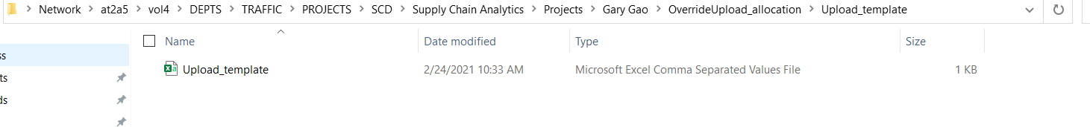
Create Template for Load IBOT Priorities 2
3. what does error_file_auto.py do ?
update `analytics-supplychain-thd.DISTRO.FP_PLAY_DLY` by error files data
create a template from that table and save as a csv for uploading:
\\at2a5\vol4\DEPTS\TRAFFIC\PROJECTS\SCD\Supply Chain Analytics\Projects\Gary Gao\OverrideUpload_allocation\Upload_template\Upload_template.csv
4. send email to Obi, Christie and Gary

Slide 16
Load IBOT Priorities
1.Go to website :
http://ibot.apps.homedepot.com/#/
2.Fill in password and Idap
(password and Idap store as pw and user in variable: should change by developer every 6 months!!! )
3. upload process will be explained in detail in next slide

Slide 17
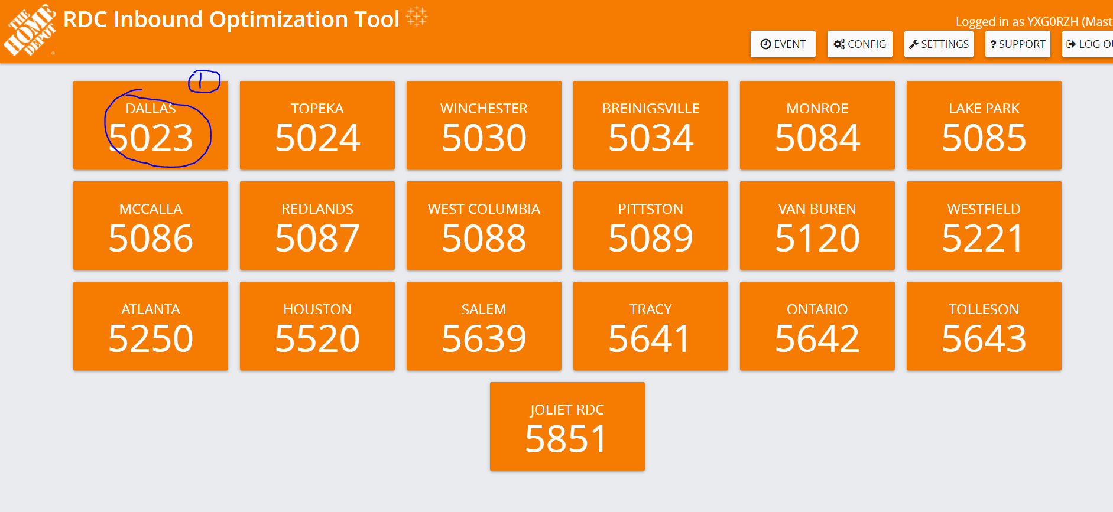
1.Click on any one RDC e.g.dallas 5023

Slide 18
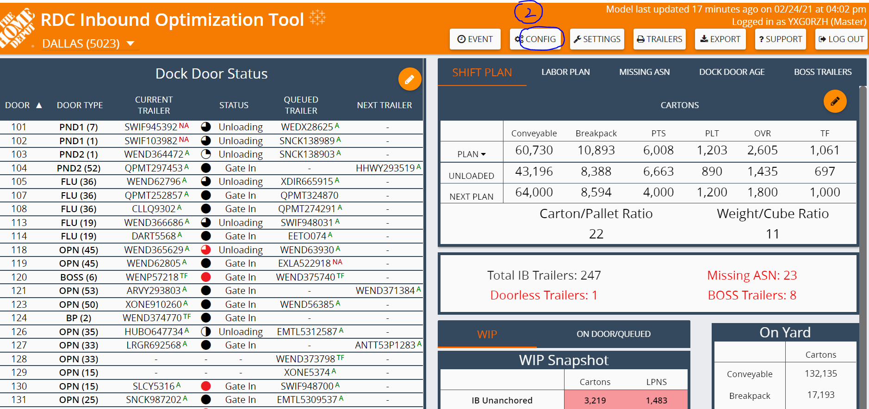
2.Click on “Config”

Slide 19
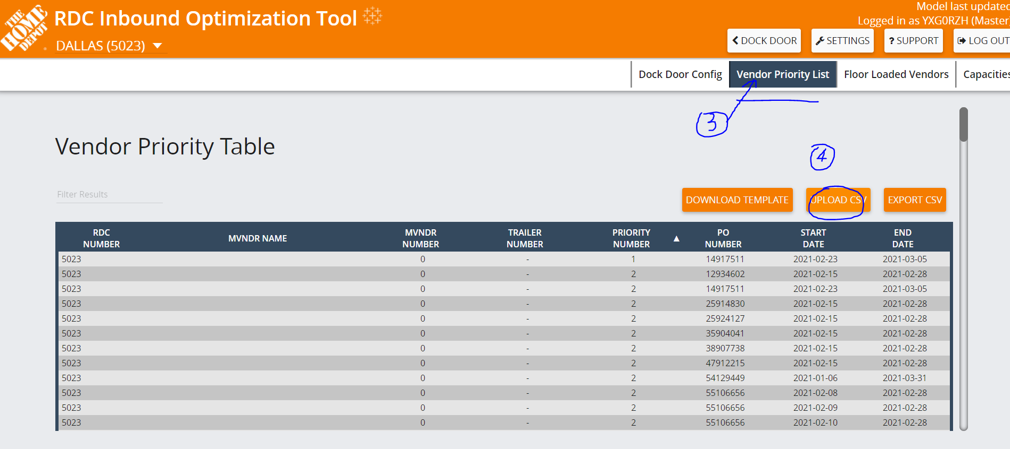
3. Click on Vendor Priority List and then click on Upload CSV: \\at2a5\vol4\DEPTS\TRAFFIC\PROJECTS\SCD\Supply Chain Analytics\Projects\Gary Gao\OverrideUpload_allocation\Upload_template\Upload_template.csv 4. send email to Obi, Christie and Gary

